Slide 1
Cloud security

Slide 2
Cloud security (also known as cloud computing security) includes many of the same security controls, technologies, practices and procedures that are used to protect physical data centers, network and compute environments—only they are deployed as a service to protect your cloud data.

Slide 3
Segmentation of cloud security responsibilities
SaaS – customers are responsible for securing their data and user access.
PaaS – customers are responsible for securing their data, user access and applications.
IaaS – customers are responsible for securing their data ,user access, applications, operating systems and virtual network traffic.

Slide 4
Security in models
Public clouds :
  Access control
  Identity management
  Authentication
Private clouds:
  Threats
  breaches
security in cloud computing is a major concern. Proxy and brokerage services should be employed to restrict a client from accessing the shared data directly. Data in the cloud should be stored in encrypted form.

Slide 5
Understanding Security of Cloud
Security Boundaries
The Cloud Security Alliance (CSA) stack model defines the boundaries between each service model and shows how different functional units relate. A particular service model defines the boundary between the service provider's responsibilities and the customer.

Slide 6
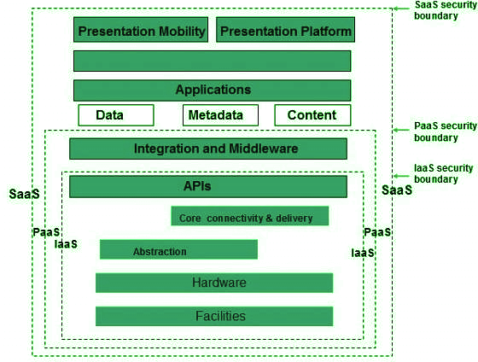
CSA stack model

Slide 7
IaaS is the most basic level of service, with PaaS and SaaS next two above levels of services.
Moving upwards, each service inherits the capabilities and security concerns of the model beneath.
IaaS provides the infrastructure, PaaS provides the platform development environment, and SaaS provides the operating environment.
IaaS has the lowest integrated functionality and security level, while SaaS has the highest.
This model describes the security boundaries at which cloud service providers' responsibilities end and customers' responsibilities begin.
Any protection mechanism below the security limit must be built into the system and maintained by the customer.
Although each service model has a security mechanism, security requirements also depend on where these services are located, private, public, hybrid, or community cloud.

Slide 8
The Cloud Security Alliance has identified the following SecaaS categories of service:
• Identity and access management
• Data loss prevention
• Web security
• security
• Security assessments
• Intrusion management
• Security information and event management
• Encryption
• Business continuity and disaster recovery
• Network security

Slide 9
identity and access management (IAM) includes people, processes, and systems that are used to manage access to enterprise resources by assuring that the identity of an entity is verified, and then granting the correct level of access based on this assured identity.
identity management is identity provisioning,which has to do with providing access to identified users and subsequently deprovisioning,or denying access, to users when the client enterprise designates such users as no longer having access to enterprise resources in the cloud

Slide 10
Data loss prevention (DLP) is the monitoring, protecting, and verifying the security of data at rest, in motion, and in use. Much of DLP can be Implemented by the cloud client,.
Web security is real-time protection offered either on premise through software/appliance installation or via the Cloud by proxying or redirecting Web traffic to the CP

Slide 11
Security assessments are third-part audits of cloud services. While this service is outside the province of the CSP, the CSP can provide tools and access points to facilitate various assessment activities.
Intrusion management encompasses intrusion detection, prevention, and response. The core of this service is the implementation of intrusion detection systems(IDSs) and intrusion prevention systems (IPSs) at entry points to the cloud and on servers in the cloud. An IDS is a set of automated tools designed to detect unauthorized access to a host system.

Slide 12
Security information and event management (SIEM) aggregates (via push or pull mechanisms) log and event data from virtual and real networks, applications,and systems. This information is then correlated and analyzed to provide real-time reporting and alerting on information/events that may require intervention or other type of response

Slide 13
Encryption is a pervasive service that can be provided for data at rest in the cloud, traffic, client-specific network management information, and identity information. Encryption services provided by the CSP involve a range of complex issues, including key management, how to implement virtual private network(VPN) services in the cloud, application encryption, and data content access.

Slide 14
Business continuity and disaster recovery comprise measures and mechanisms to ensure operational resiliency in the event of any service interruptions. This service must include a flexible infrastructure, redundancy of functions and hardware,monitored operations, geographically distributed data centers, and network survivability.
Network security consists of security services that allocate access, distribute,monitor, and protect the underlying resource services. Services include perimeterand server firewalls and denial-of-service protection

Slide 15
Understanding data security
Since all data is transferred using the Internet, data security in the cloud is a major concern. Here are the key mechanisms to protect the data.
  access control
  audit trail
  certification
  authority

Slide 16
Separate access to data
  Since the data stored in the cloud can be accessed from anywhere, we need to have a mechanism to isolate the data and protect it from the client's direct access.
Broker cloud storage is a way of separating storage in the Access Cloud.

Slide 17
A broker has full access to the storage but does not have access to the client.
A proxy does not have access to storage but has access to both the client and the broker.
Working on a Brocade cloud storage access system
When the client issues a request to access data:
The client data request goes to the external service interface of the proxy.

Slide 18
The proxy forwards the request to the broker.
The broker requests the data from the cloud storage system.
The cloud storage system returns the data to the broker.
The broker returns the data to the proxy.
Finally, the proxy sends the data to the client.

Slide 19
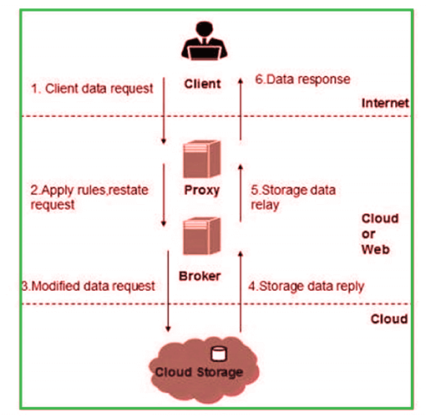

Slide 20
What are the Security Risks of Cloud Computing
Data Loss
Hacked Interfaces and Insecure APIs
Data Breach
Vendor lock-in
Increased complexity strains IT staff
Spectre & Meltdown
Denial of Service (DoS) attacks
Account hijacking

Slide 21
Data Loss
Data loss is the most common cloud security risks of cloud computing. It is also known as data leakage. Data loss is the process in which data is being deleted, corrupted, and unreadable by a user, software, or application. In a cloud computing environment, data loss occurs when our sensitive data is somebody else's hands, one or more data elements can not be utilized by the data owner, hard disk is not working properly, and software is not updated.

Slide 22
Hacked Interfaces and Insecure APIs
cloud computing is completely depends on Internet, so it is compulsory to protect interfaces and APIs that are used by external users. APIs are the easiest way to communicate with most of the cloud services. In cloud computing, few services are available in the public domain.
These services can be accessed by third parties, so there may be a chance that these services easily harmed and hacked by hackers.

Slide 23
Data Breach
  Data Breach is the process in which the confidential data is viewed, accessed, or stolen by the third party without any authorization, so organization's data is hacked by the hackers.
Vendor lock-in
  Vendor lock-in is the of the biggest security risks in cloud computing. Organizations may face problems when transferring their services from one vendor to another. As different vendors provide different platforms, that can cause difficulty moving one cloud to another.

Slide 24
Increased complexity strains IT staff
  Migrating, integrating, and operating the cloud services is complex for the IT staff. IT staff must require the extra capability and skills to manage, integrate, and maintain the data to the cloud.
Spectre & Meltdown
  Spectre & Meltdown allows programs to view and steal data which is currently processed on computer. It can run on personal computers, mobile devices, and in the cloud. It can store the password, your personal information such as images, emails, and business documents in the memory of other running programs.

Slide 25
Denial of Service (DoS) attacks
  Denial of service (DoS) attacks occur when the system receives too much traffic to buffer the server. Mostly, DoS attackers target web servers of large organizations such as banking sectors, media companies, and government organizations. To recover the lost data, DoS attackers charge a great deal of time and money to handle the data.

Slide 26
Account hijacking
  Account hijacking is a serious security risk in cloud computing. It is the process in which individual user's or organization's cloud account (bank account, e-mail account, and social media account) is stolen by hackers. The hackers use the stolen account to perform unauthorized activities.

